Slide 1
Identifying Congestion Patterns in the NYC MTA
By: Hyunjin Kim

Slide 2
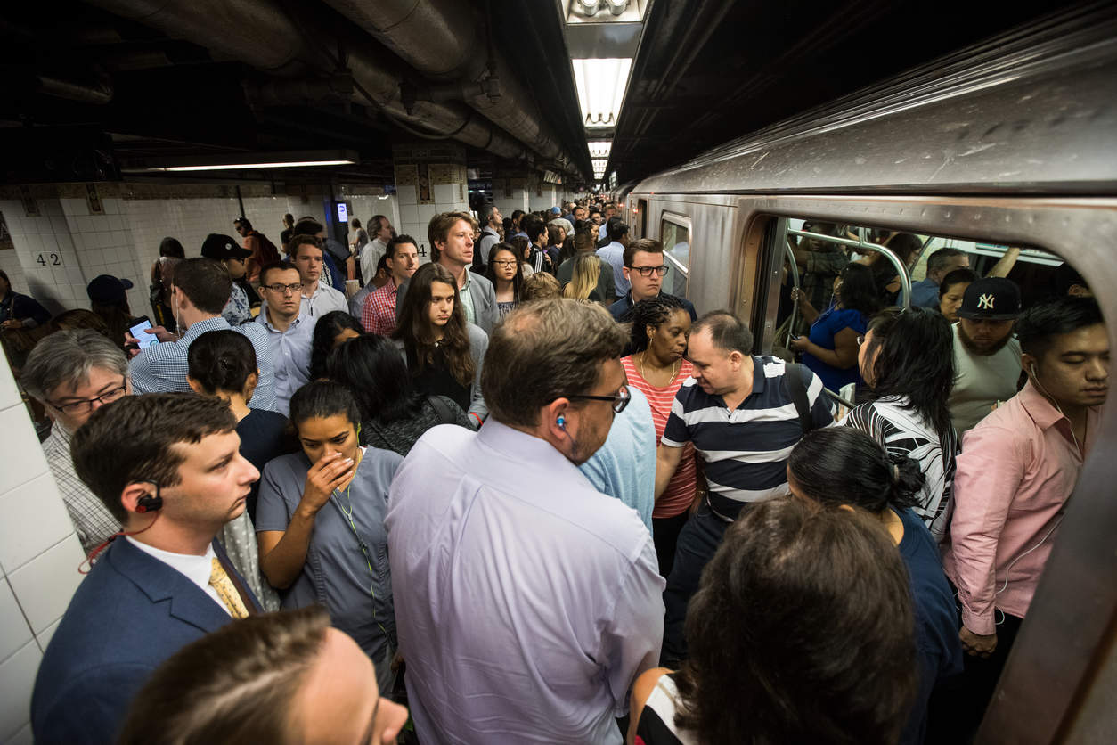
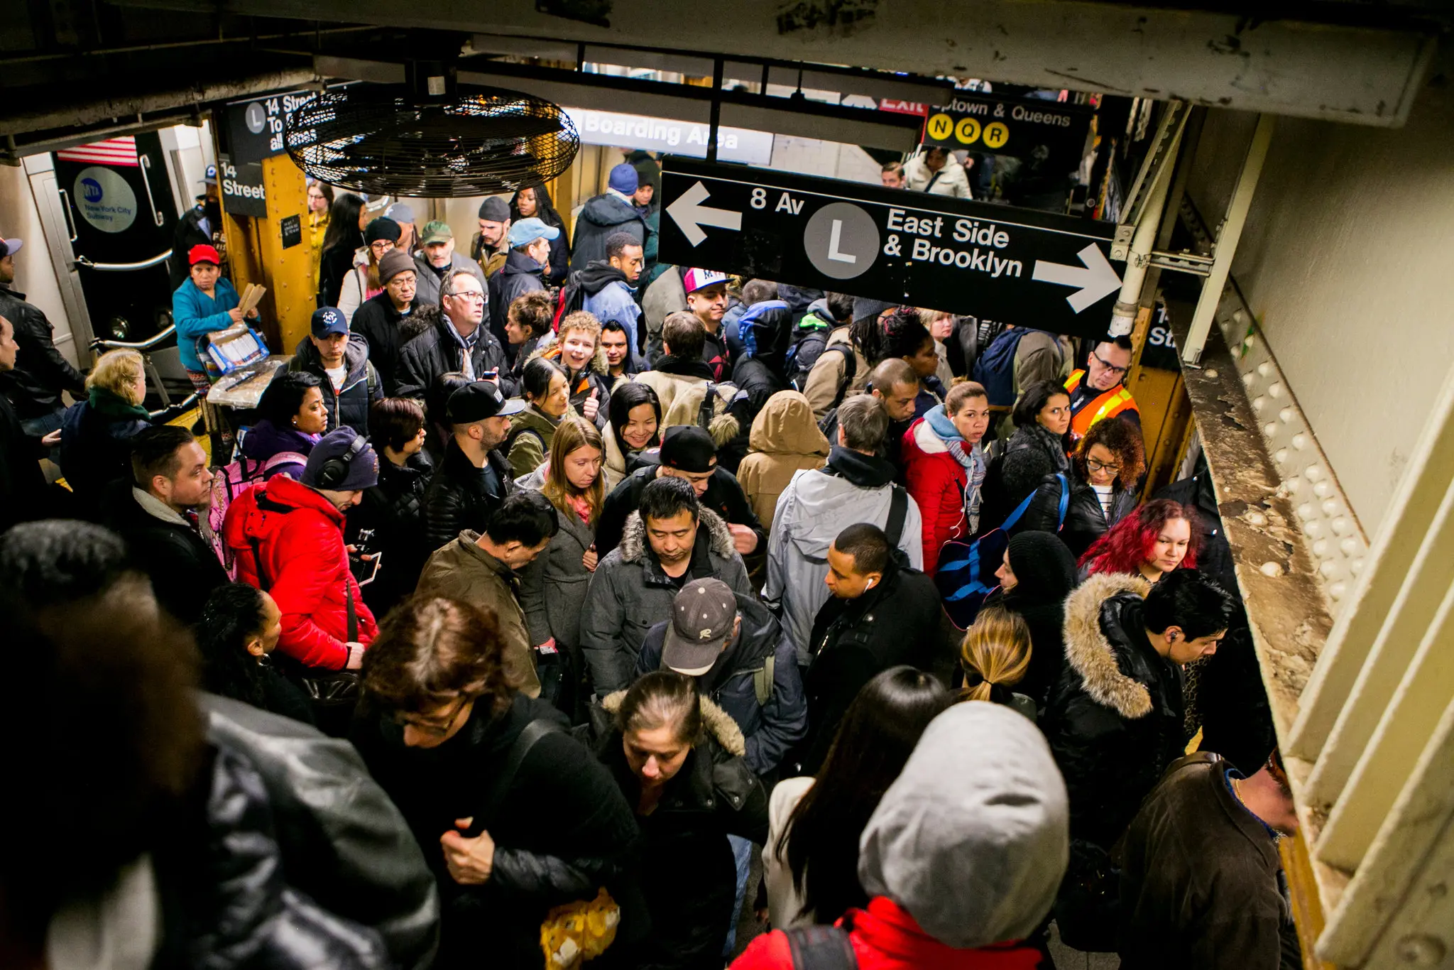
NYC MTA
Objective: To identify factors contributing to congestion and develop strategies to mitigate the issue.

Slide 3
Data Sources
Four sources were used:
Historical MetroCard History data
US Holidays
Historical Gasoline Prices
Historical Weather data
Key Columns:
From Date - To Date
Station
Total Fares for the Week
Contains Holiday
Gas Price
Total Snowfall/ Total Rainfall

Slide 4
Data Assumptions and Limitations
Handling Missing Values
MetroCard History: - Null values replaced with 0 - Assumption: No passengers used the specific fare type in the given time period
Gas Price: - Forward fill used to impute missing values -Assumption: Gas prices remain constant until the next recorded price change.
Handling Missing Values
Weather Data: - Focus only on snowfall and rainfall - Assumption: Snow and rain have a more significant impact on ridership
Limitations - Assumptions simplify analysis but may not capture all nuances - Other weather factors or events may influence ridership patterns

Slide 5
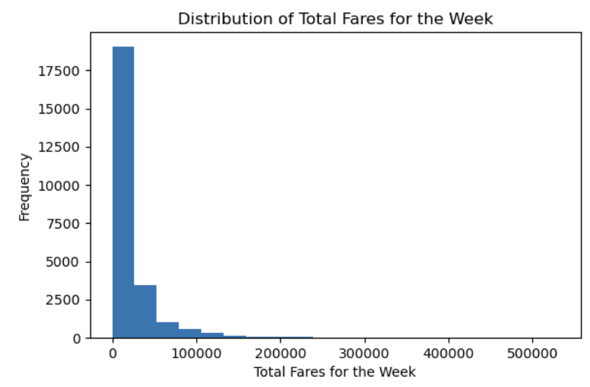
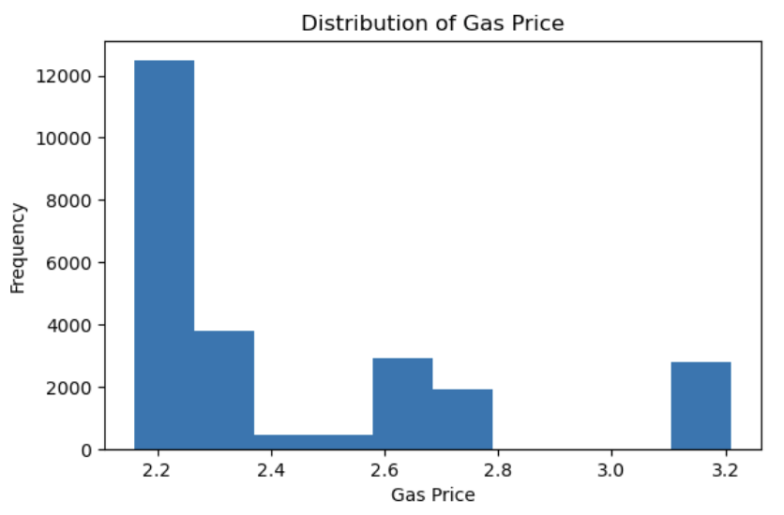
EDA - Part 1

Slide 6
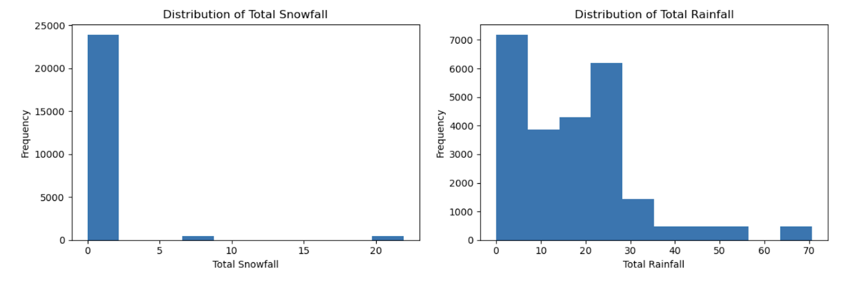
EDA - Part 2
Most of the data is right skewed
We will need to select a model that is less sensitive to distribution.

Slide 7
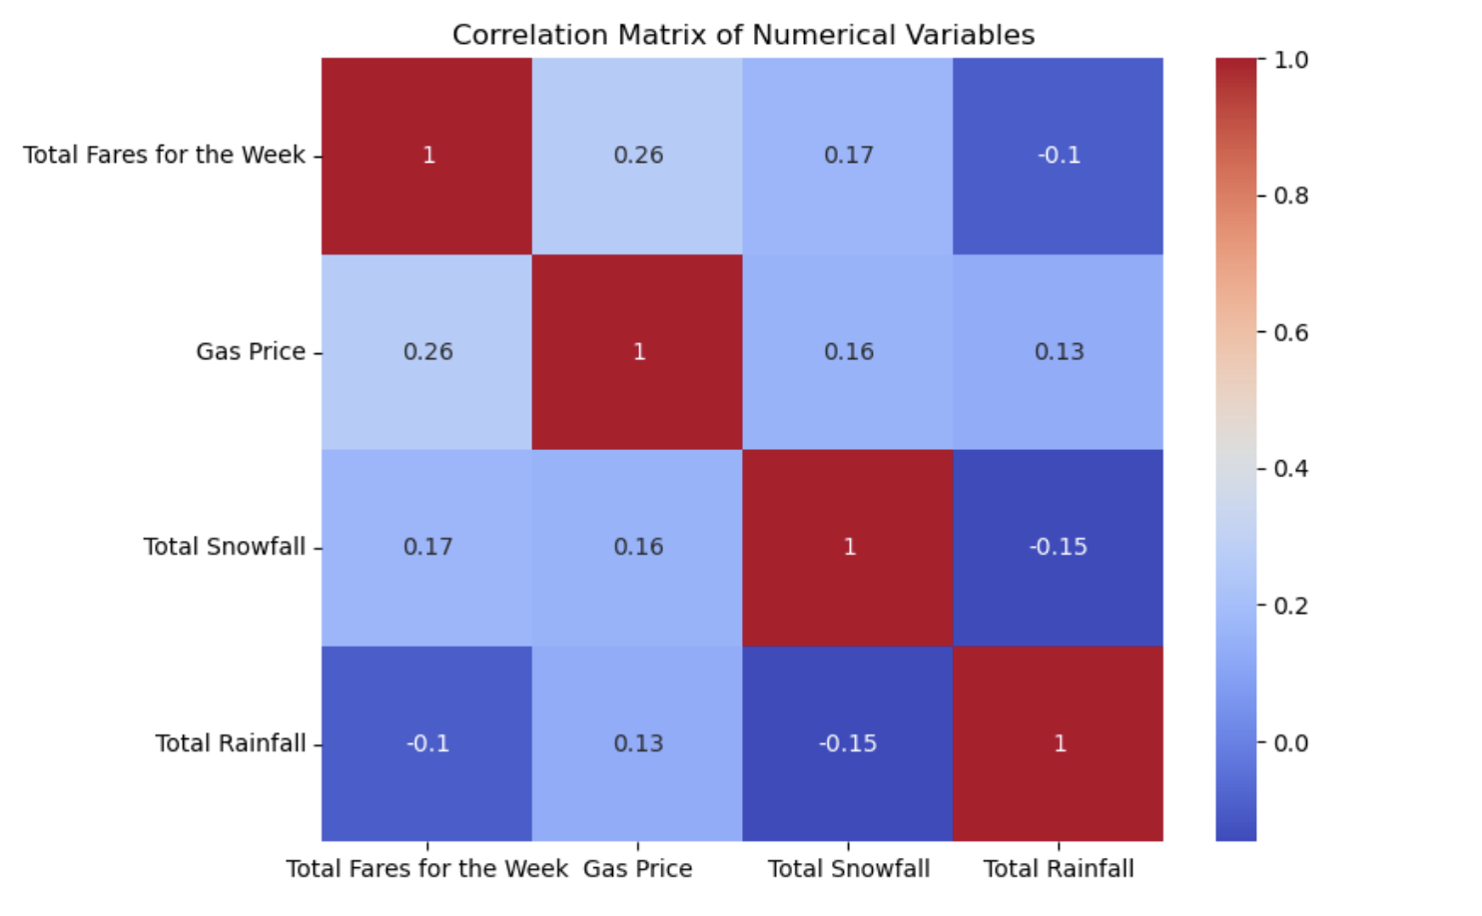
Correlation Matrix
There are no really strong correlations
Rain seems to have a negative effect on ridership
Gas price seems to have the largest positive effect on ridership

Slide 8
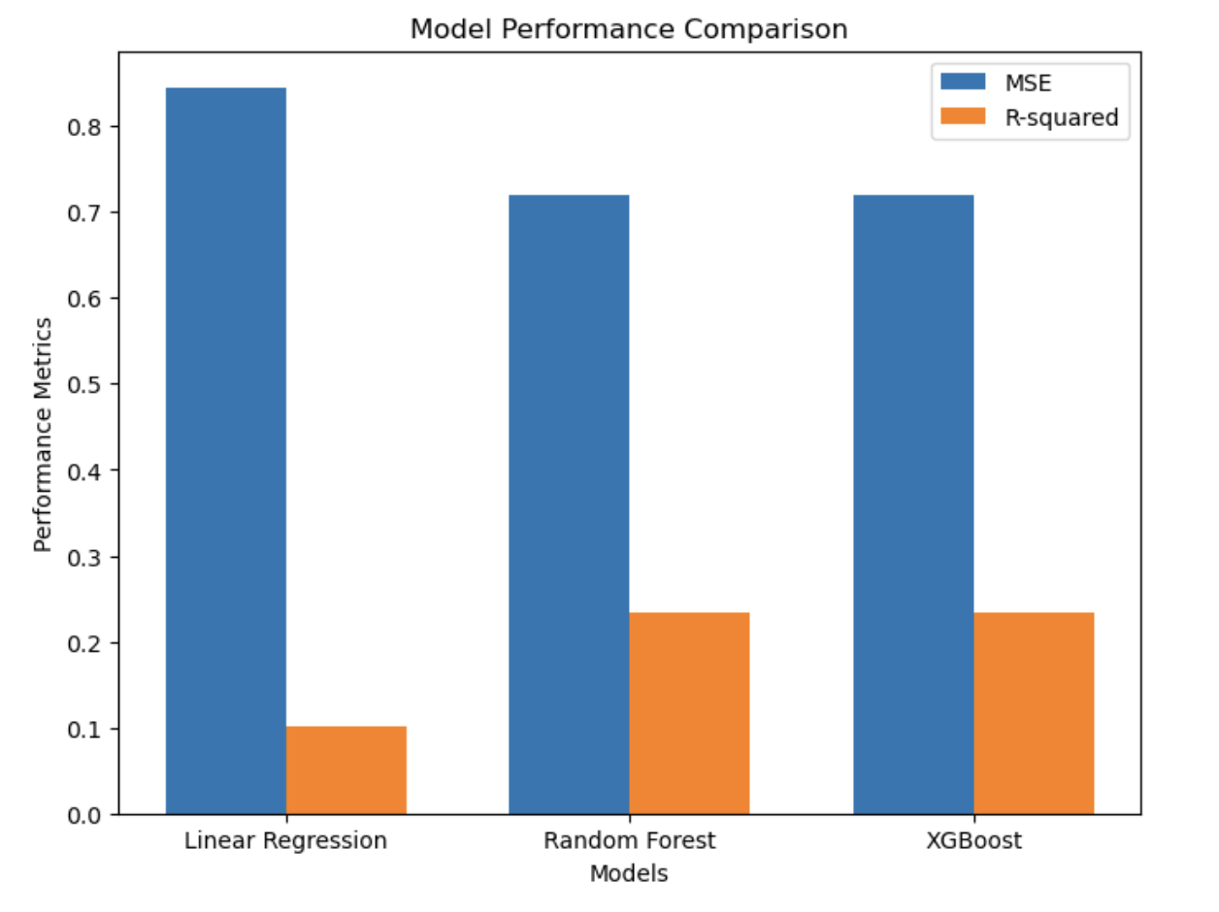
Model Development
MSE - Lower value means better accuracy
R-squared - How well does the model explain variation, numbers closer to 1 are better.

Slide 9
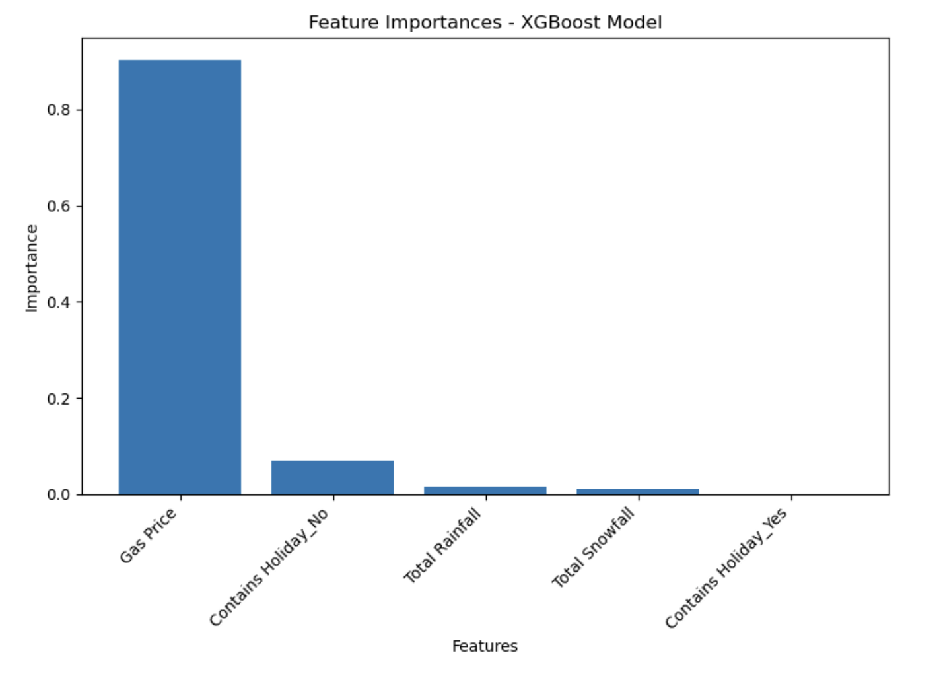
Feature Importance
Higher gas prices are associated with increased MTA ridership and total fares
Weeks without holidays tend to have lower total fares compared to weeks with holidays
Weather factors have relatively lower importance

Slide 10
Key Findings
Higher gas prices = increase in ridership
Weeks with holidays experience higher ridership
Weather factors have little to no impact in predicting congestion

Slide 11
Recommendations
Implement dynamic pricing that adjusts fares based on gas prices - Encourage the use of public transport during times of higher gas prices
Focus on managing congestion during times of gas price changes and holiday periods - Increase service frequency or implement holiday specific pricing to mitigate the impact of holidays
Offer incentives for off-peak travel

Slide 12
Future Work
Short Term (1-3 months):
Expand the feature set - Explore additional features that may impact congestion e.g. Economic indicators, population density, major events (e.g. sporting events, concerts)
Medium Term (3-6 months):
Analyze time series patterns - Investigate daily, weekly, or seasonal variations in congestion
Experiment with advanced machine learning models - Explore deep learning or ensemble methods to capture complex relationships
Long Term (6-12 months):
Develop a congestion management dashboard - Create a user-friendly interface that displays real-time congestion levels
Implement continuous monitoring and model updates - Regularly update the models with new data to capture changes in ridership patterns

Slide 13
Thank you! Questions, comments
Hyunjin Kim:
example@email.com
917-000-0000

